Slide 1
Problem and objective
Anyone who has been booked a flight ticket knows how unexpectedly the prices vary. The cheapest available ticket on a given flight gets more and less expensive over time. This usually happens as an attempt to maximize revenue based on - 1. Time of purchase patterns (making sure last-minute purchases are expensive) 2. Keeping the flight as full as they want it (raising prices on a flight which is filling up in order to reduce sales and hold back inventory for those expensive last-minute expensive purchases) So, we worked on a project where we collected data of flight fares with other features and worked to make a model to predict fares of flights.
Problem to explore:
• Which variables are important to predict the price of variable?
• How do these variables describe the price.

Slide 2
Dataset Exploration
The dataset contains 1792 rows and 8 columns
Fare is our dependent variable.
We created new features from old ones.
All columns were object data types we converted necessary ones into int and float.
There are no null values in the dataset.
Trimmed few columns

Slide 3
Data Cleaning & Pre-processing
#cleaning data
df["Departure Time"]=df["Departure Time"].str.split("\n").str[0]
df['Arrival Time'] = df["Arrival Time"].str.split("\n").str[0]
df["Departure Time"]=df["Departure Time"].str.split(":").str[0]
df['Arrival Time'] = df["Arrival Time"].str.split(":").str[0]
df["Numbers of stops"] = df["Numbers of stops"].str.split("\n").str[1]
#departure time/arrival time
df['Departure Time'] = df['Departure Time'].apply(flight_dep_time)
df['Arrival Time'] = df['Arrival Time'].apply(flight_dep_time)
#spliting duration in hours and minutes and converting them into int type
df["H"]=df["Total Time Taken"].str.split("h").str[0]
df["M"]=df["Total Time Taken"].str.split("h").str[1]
df["M"]=df["M"].str.split("m").str[0]
df["M"].fillna(0,inplace=True)
df.drop(df.index[df['H'] == '5m'], inplace = True)
df.replace(to_replace="", value='0', inplace=True)
df["H"]=df["H"].astype(int)
df["M"]=df["M"].astype(int)

Slide 4
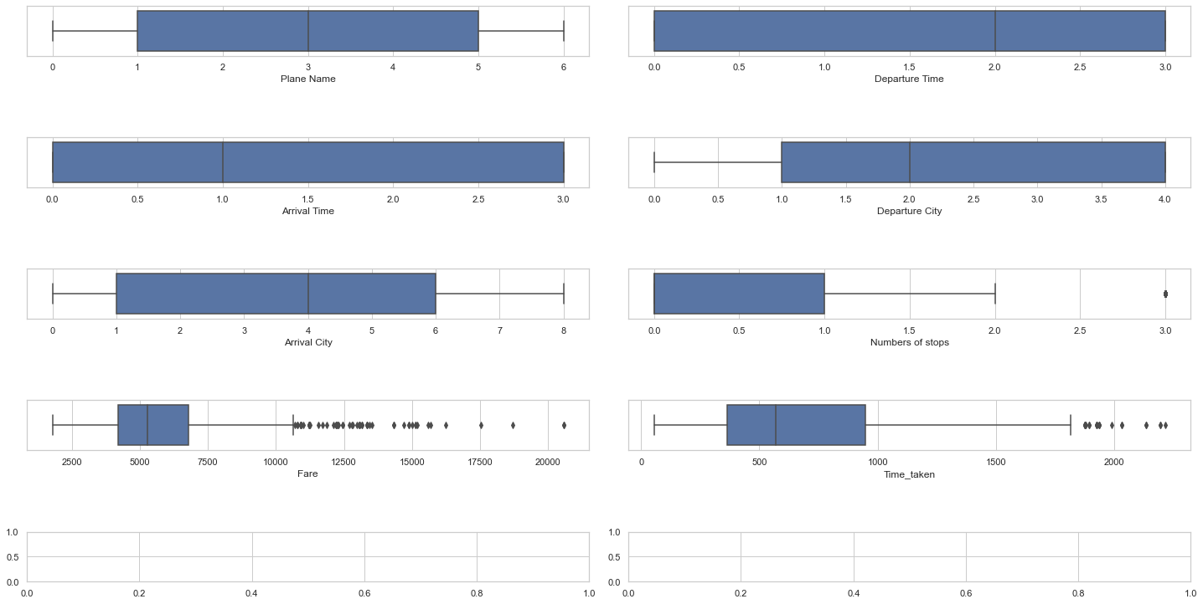
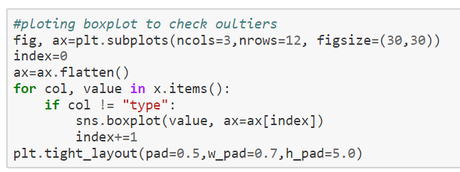
Outliers detection

Slide 5
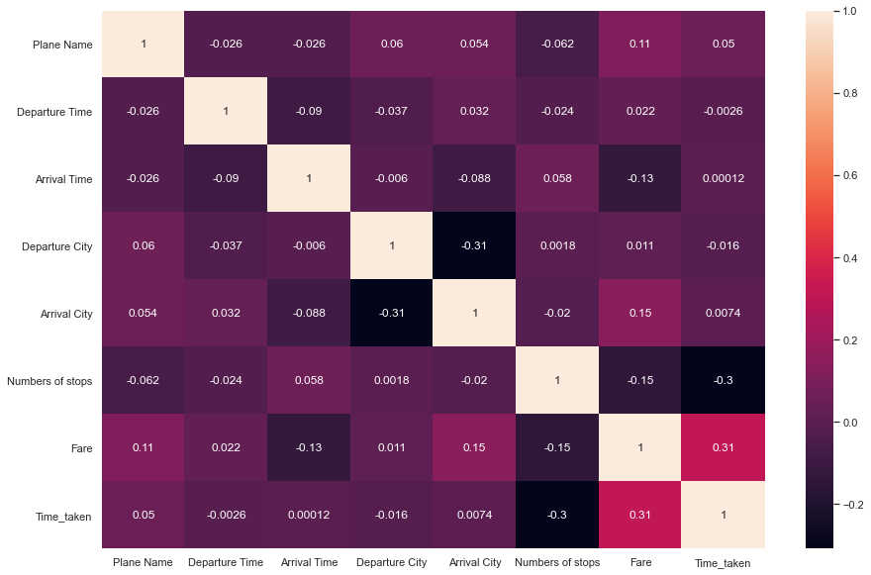
Correlation of variables using heatmap
#fare is highly correlated with time taken

Slide 6
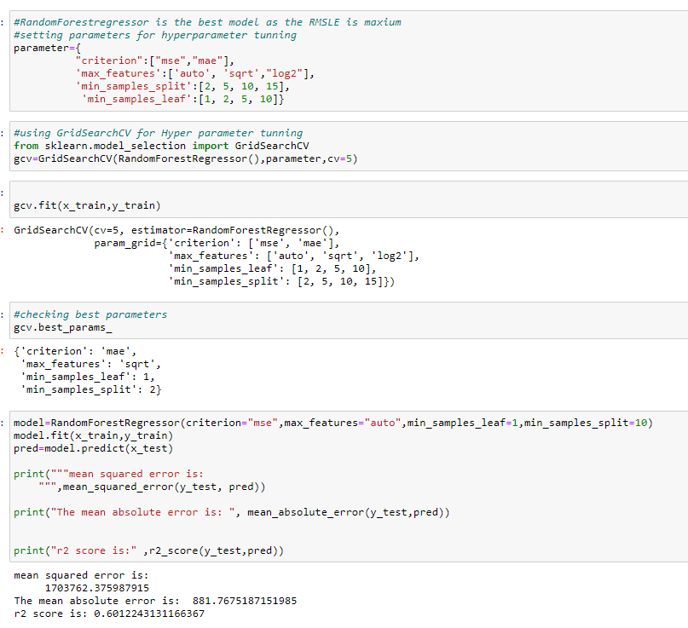
Hyperparameter Tunning
GridsearchCv has been used for hyperparameter tunning
Then the model was retrained with the best parameters

Slide 7
CONCLUSION
This research showed the model training process for the prediction of the Price. One of the objectives of the paper was to check the important variable for the prediction of the price and how these variables describe the price. Through model training and evaluating its performance. RandomForestRegressor proved to be as best model. As the difference between the r2score and cross validation score was minimum. This project has increased my understanding of the concept. During the research I came across various challenges and while solving them I learned a lot of new things. For example. How to plot different charts. For example, I learned how to plot subplot. I learned new libraries and how to use them. I explored various methods for feature selection. Also, I came to understand how can multicollinearity can cause problem during the model training. The limitation of the solution provided is that the data carried a lot of unrealistic values. Apart from that my laptop took to much time while running certain command where I lost a lot of precious time.

